Slide 1
A lecture video on Constructing solutions using Unified kinematic wave theory for melt infiltration into firn*
Mohammad Afzal Shadab
mashadab@princeton.edu
Future Faculty in Physical Sciences Postdoctoral Fellow
Princeton University
*Shadab, Rutishauser, Grima and Hesse, Journal of Glaciology (2025)

Slide 2
Unified kinematic wave theory
Kinematic wave theory: a framework to describe propagation of waves influenced by the motion of particles (kinematics) rather than the forces acting on them (dynamics) [Lighthill and Whitham, 1955]
Unified: the theory is not derived from prior kinematic wave theories but still unifies most previous work and extends to perched aquifers

Slide 3
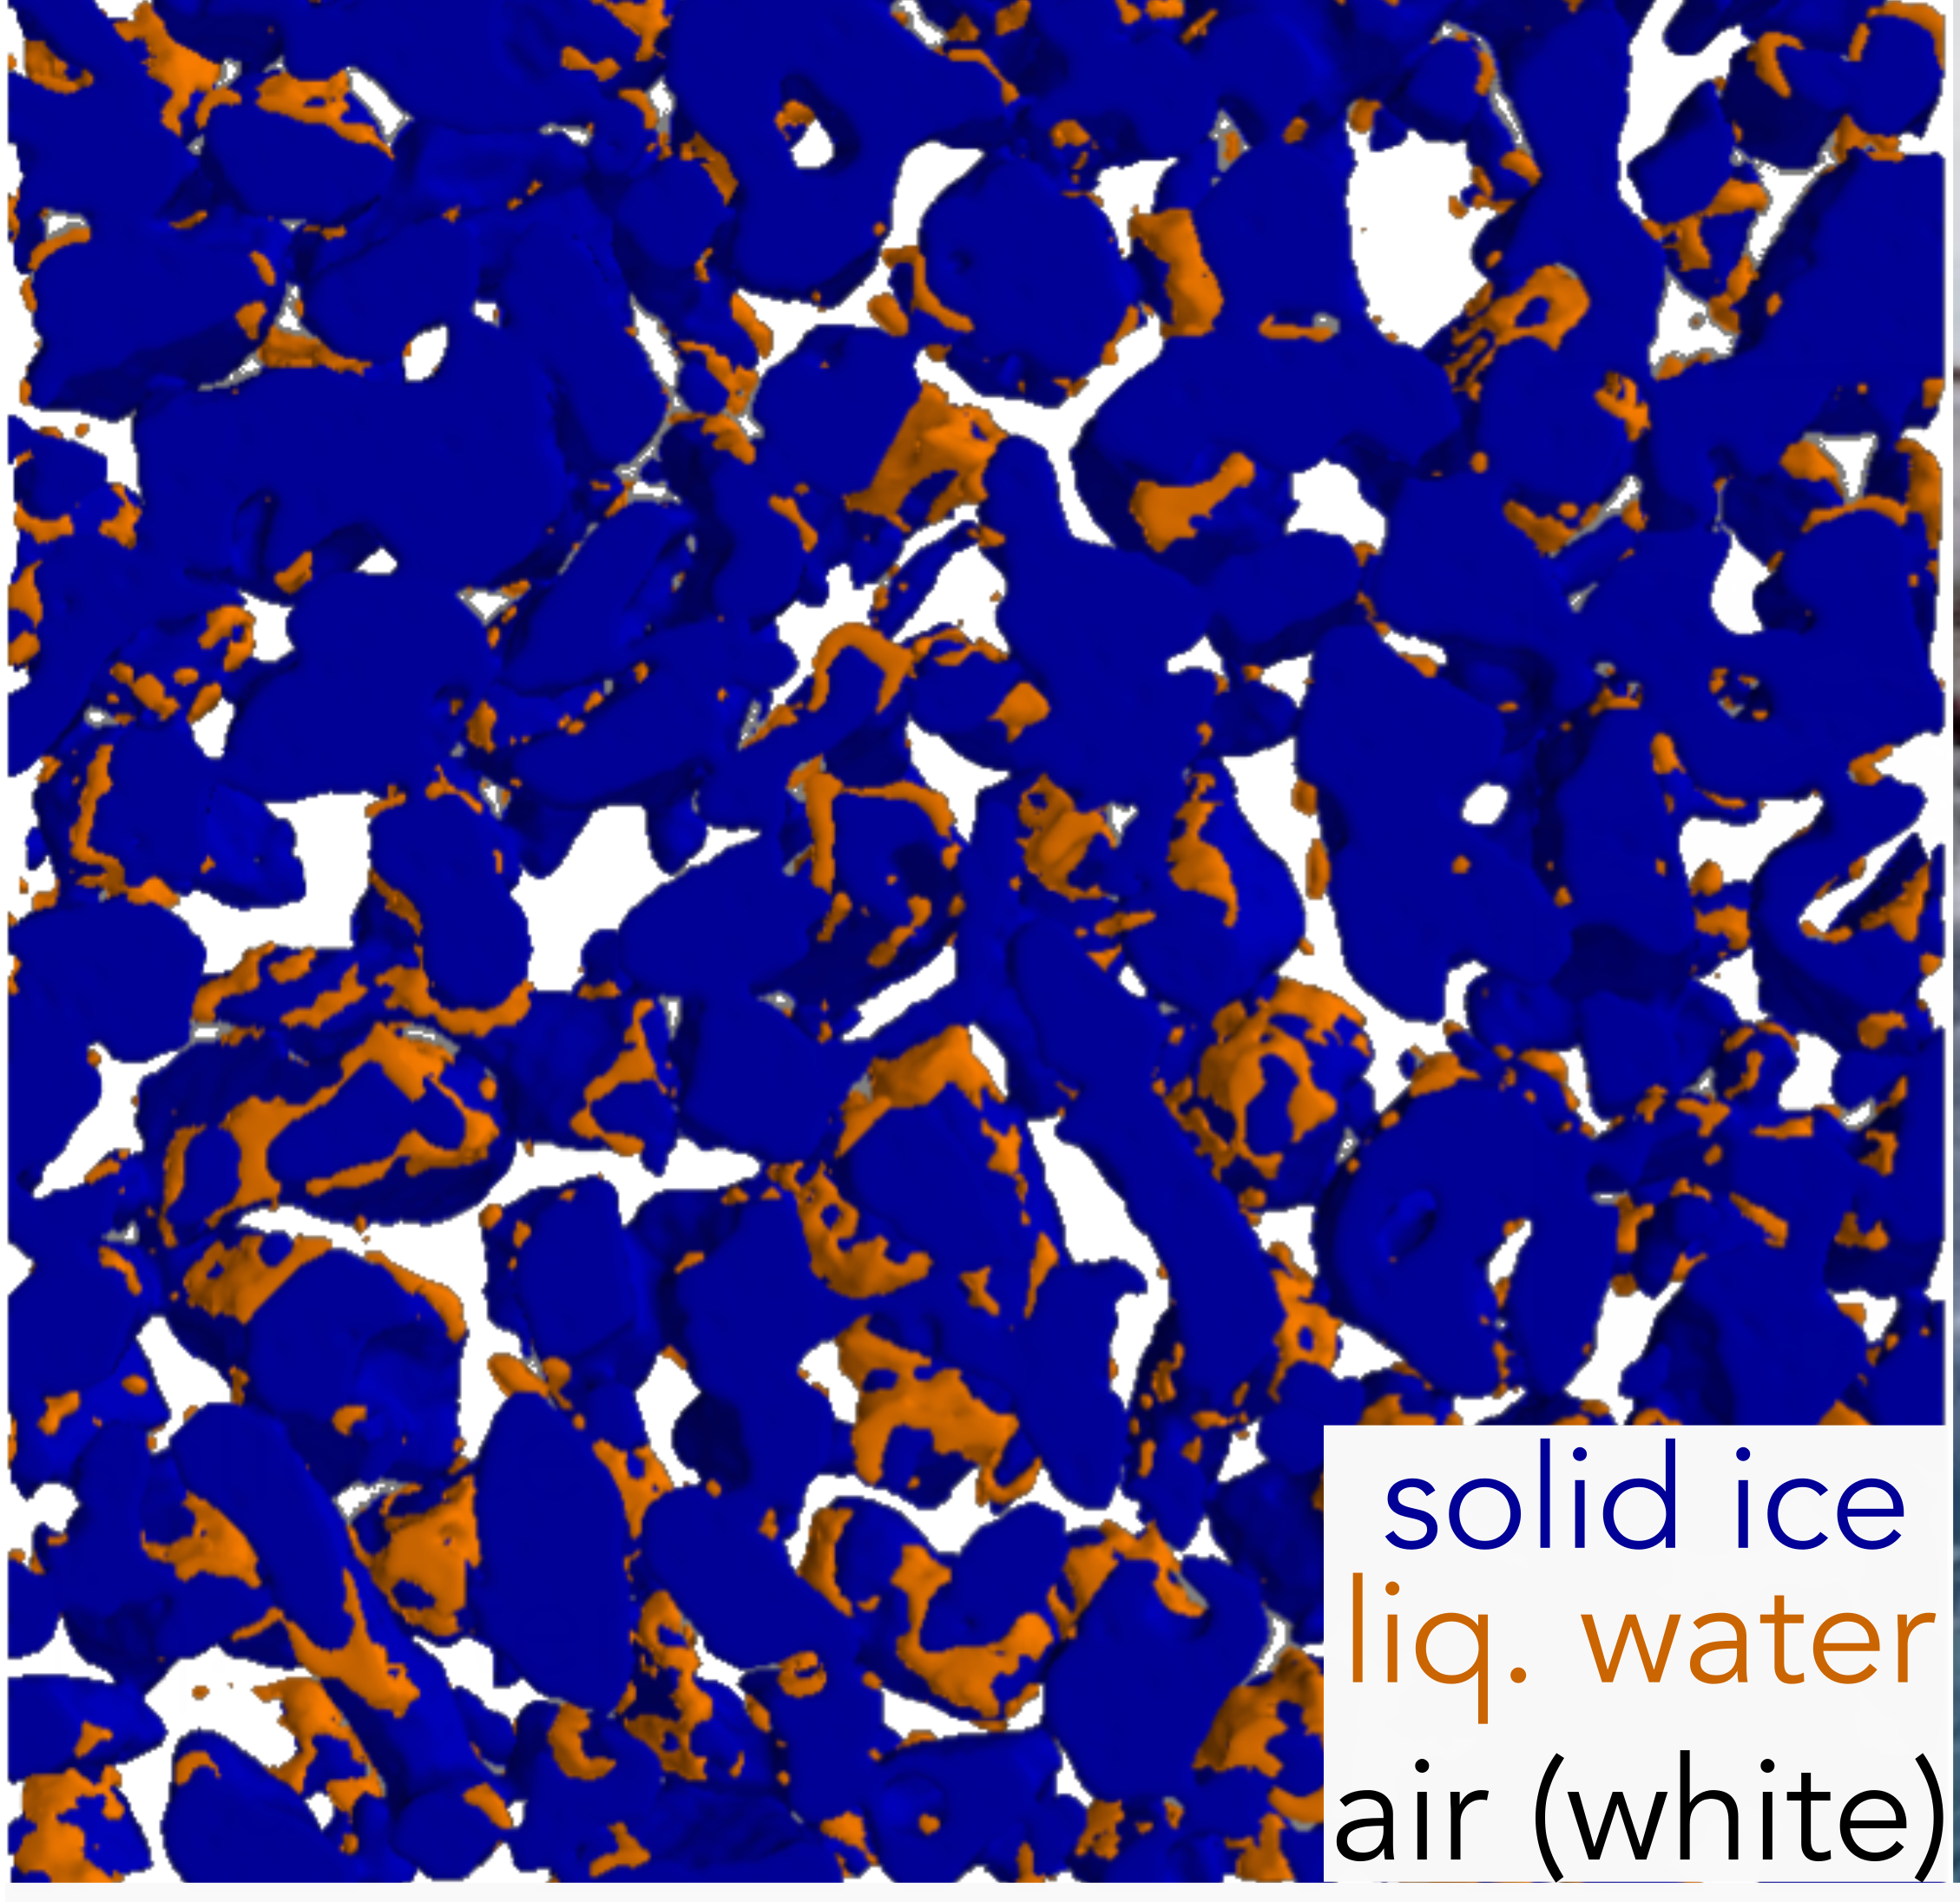
Fundamentals
CT scan of Wet snow
[Ebner et al., 2020]
Assumptions:
Density of liquid water is same as of ice
No heat conduction
No capillary forces
Local thermodynamic equilibrium
Zero residual water saturation
Here Ice sp. heat = 2106.1 J/(kg K), Latent heat of fusion of water = 333.55 kJ/kg, & Melting Temp. = 273.16 K

Slide 4
Fundamentals
CT scan of Wet snow
[Ebner et al., 2020]
Assumptions:
Density of liquid water is same as of ice
No heat conduction
No capillary forces
Local thermodynamic equilibrium
Zero residual water saturation
Dimensionless variables:
Dim-less. Composition = Ice vol. fraction + Liquid water content
Dim-less. Enthalpy = Dim-less Composition * Ice sp. heat * (Temp. – Melting Temp.)
Latent heat of fusion of water
, for Dim-less Enthalpy< 0, or
=Liquid water content, for 0<Dim-less Enthalpy<Dim-less. Composition.
Porosity = 1 - Dim-less. Composition + max(0, Dim-less. Enthalpy)
Here Ice sp. heat = 2106.1 J/(kg K), Latent heat of fusion of water = 333.55 kJ/kg, & Melting Temp. = 273.16 K

Slide 5
Dimensionless Temp. = (Temperature – Melting temp.)
Melting Temp.
Liquid water content
Dimensionless Enthalpy
Dimensionless Enthalpy
Dimensionless Composition
Dimensionless Composition

Slide 6
Dimensionless flux of dimensionless composition or enthalpy
Dimensionless Enthalpy
Dimensionless Composition

Slide 7
Steps to construct solution
Problem: Initial value problem with a jump
Steps to sketch an analytic solution
Calculate dimensionless composition and enthalpy
from initial condition
Plot the top & bottom states on Composition –
Enthalpy hodograph plane
Connect the state points appropriately via
slow path (constant flux lines)
fast path (constant porosity lines)
extended path
Extract physical quantities from resulting solution
Hodograph plane

Slide 8
Cases with temperate firn (Three phase region only)

Slide 9
Case I: Steady melt flux in temperate firn
(0.895,0.45)
(0.7,0.4)

Slide 10
Case II: Melt flux decays with time (drying)
(0.85,0.55)
(0.7,0.4)

Slide 11
Case III: Melt flux rises with time (wetting)
(0.7,0.4)
(0.5,0.2)

Slide 12
Case IV: Melt flux decays with time with change in porosity
(0.948,0.528)
(0.538,0.117)
(0.3,0.1)

Slide 13
Case V: Melt flux rises with time with change in porosity
(0.648,0.448)
(0.948,0.528)
(0.3,0.1)

Slide 14
Case VI: Melt flux rise with time with change in porosity (leading to perched water table)
(1.0,0.5)
(0.9,0.4)
(1.0,0.3)
(0.8,0.1)

Slide 15
Cases with cold firn

Slide 16
Case VII: Two-layer cold firn with no melt
(0.6,0.0)
(0.8,-0.1)

Slide 17
Case VIII: Cold firn overlying wet, temperate firn
(0.8,0.6)
(0.2,0.0)
(0.7,-0.1)

Slide 18
Case IX: Sudden rise in melt flux in cold firn
(0.80,0.25)
(0.5,-0.05)

Slide 19
Case X: Sudden rise in melt flux in cold firn with step change in porosity
(0.893,0.163)
(0.4,0.1)
(0.65,-0.08)

Slide 20
Case XI: Sudden rise in melt flux in cold firn leading to perched water table formation
(1.0,0.8)
(0.85,0.65)
(1.0,0.4)
(0.5,-0.1)

Slide 21
Case XII: Sudden rise in melt flux in cold firn leading to perched water table formation
(1.0,0.7)
(0.95,0.65)
(1.0,0.0)
(0.95,-0.18)

Slide 22
Validation: Infiltration in multilayered firn

Slide 23
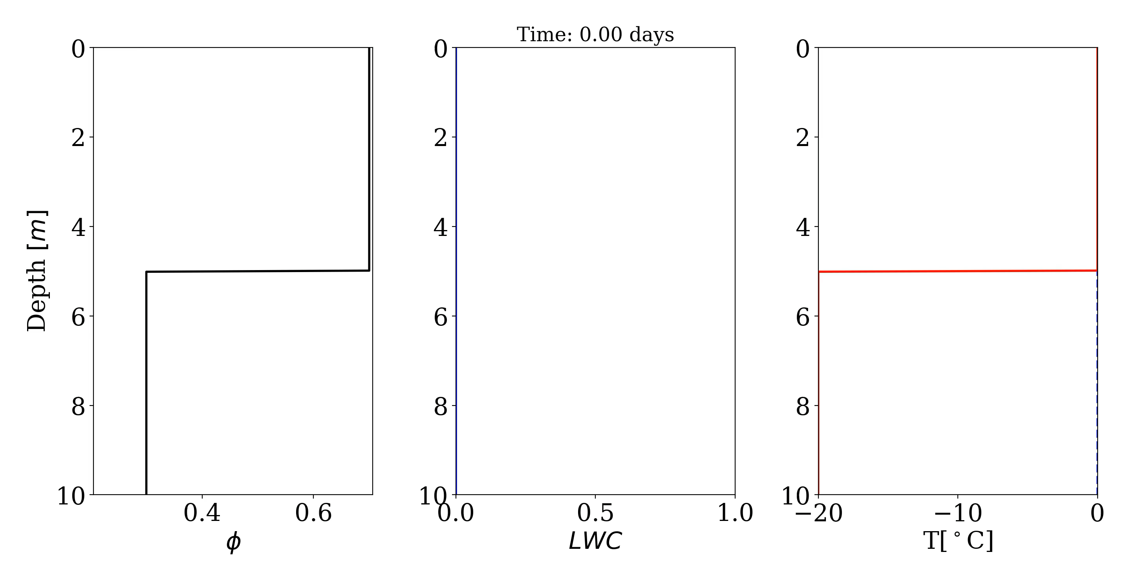
Numerical solution without heat cond.

Slide 24
Comparison against analytic solution

Slide 25
Comparison against analytic solution

Slide 26
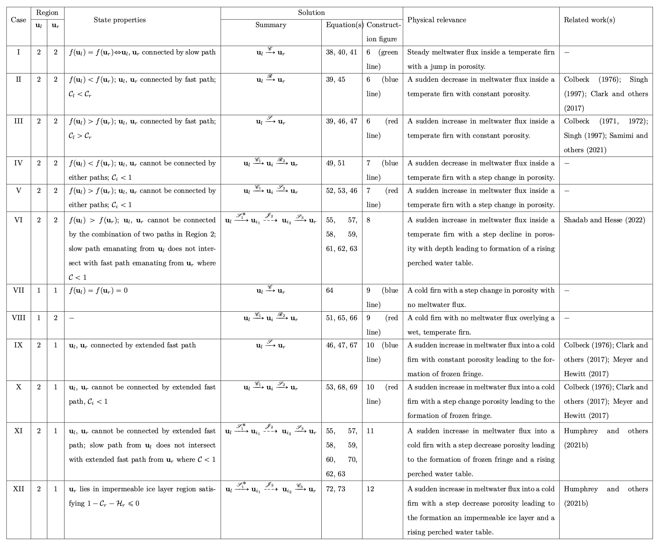
Please refer to Table 2 of manuscript

Slide 27
In summary
UKWT can help analyze many problems in wet firn only by “good sketching skills”
It helps predict the formation of leaky perched aquifers vs impermeable ice layers via refreezing due to heat advection
Simple cases could be combined to form complex problems which compare well against numerical simulations
The solutions can be used as benchmarks to validate and improve firn hydrology, ice-sheet and Earth system models
Table 2 in the manuscript has a nice summary of all solutions!
Code to generate analytic solutions is available on Github: https://github.com/mashadab/unified-kinematic-wave-theory

Slide 28
Thank you! For any questions, please contact me at mashadab@princeton.edu

